Slide 1
BHS Billing Unit
Billing Office Hours
August 27, 2026

Slide 2

Meeting Agenda
BHS BU New Contact Info
SOC (System of Care) Reminder:
  Charges staged to 9999 plan have been reviewed/resolved – focus on DOS that is fast approaching timely filing deadline with DHCS (12 months from DOS).
  SmartCare Client Plan Request should be submitted for clients with no coverage or lapsed coverage on CoSD Client Insurance and Date Span Report
  Charges staged to Private Insurance and Medicare plans have been billed. Submit EOBs to MHBillingUnit or SUDBillingUnit where applicable.
  Review/Resolve Service Errors
MHBU – BH Connect EBP Bundled Services
  CoSD Service Error Report
  CoSD Authorizations Report
  CalMHSA 120 –CalMHSA BH Connect Monthly Services Report
  CoSD Charges and Claims Report
SUDBU
  Topic
Data Quality - MyReportedErrors
Q&A

Slide 3

BHS Billing Unit Contact Information
BHS Billing Unit - Mental Health and Substance Use Disorder new email addresses. Effective immediately, please send the:
MH billing and billing-related emails to: MHBillingUnit.BHS@sdcounty.ca.gov
ADP or SUD billing and billing-related emails to: SUDBillingUnit.BHS@sdcounty.ca.gov
The BHS Billing Unit's old email addresses will remain active and monitored until 08/31/2026.
MHBillingUnit.HHSA@sdcounty.ca.gov (MH)
ADSBillingUnit.HHSA@sdcounty.ca.gov (SUD)
Please refer to our contact details and updates in the business email signature.

Slide 4
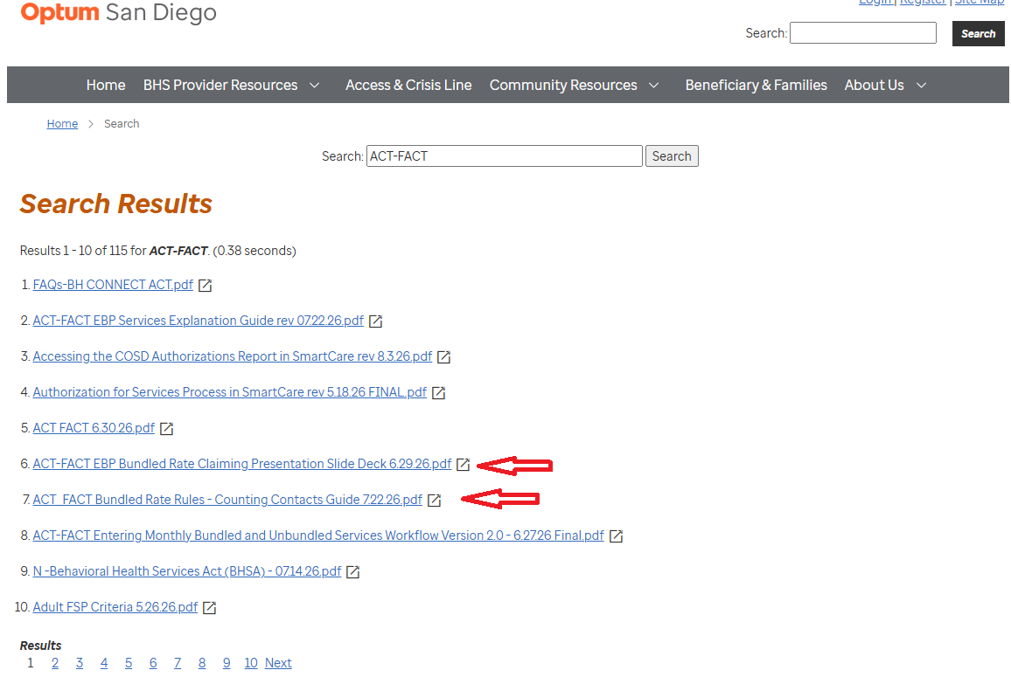
BH Connect ACT/FACT EBP Resources
Notes:
Staff can now more easily review a client’s ASCMI consent preferences as captured within SmartCare by navigating to the Client Information Screen (Custom Fields tab) and viewing the summary of the client’s ASCMI data sharing preferences for each data type, as well as the date of signature and form expiration date.
This section will automatically update with any new ASCMI data captured within SmartCare on a per-client basis.

Slide 5
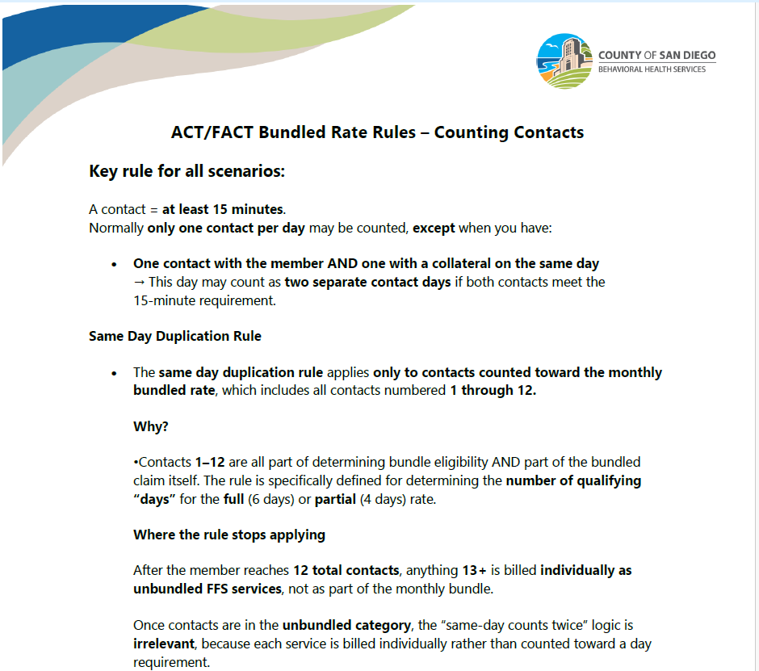
ACT/FACT Bundled Rate Rules – Counting Contacts Guide

Slide 6
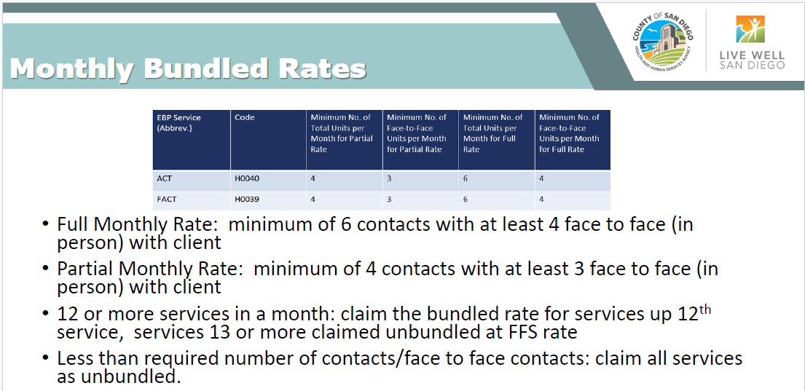
ACT-FACT EBP Bundled Rate Claiming Presentation
Notes:
To support documentation consistency and prevent an unintentionally blank field, the Other General Medical Conditions field in the SmartCare Diagnosis document will now automatically populate with 'N/A' by default.
What this means for staff:
• If the person you are supporting has no other significant general medical conditions, no action is needed — N/A will remain in the field.
• If there are relevant medical conditions to document, simply delete the text and enter the appropriate clinical information.

Slide 7
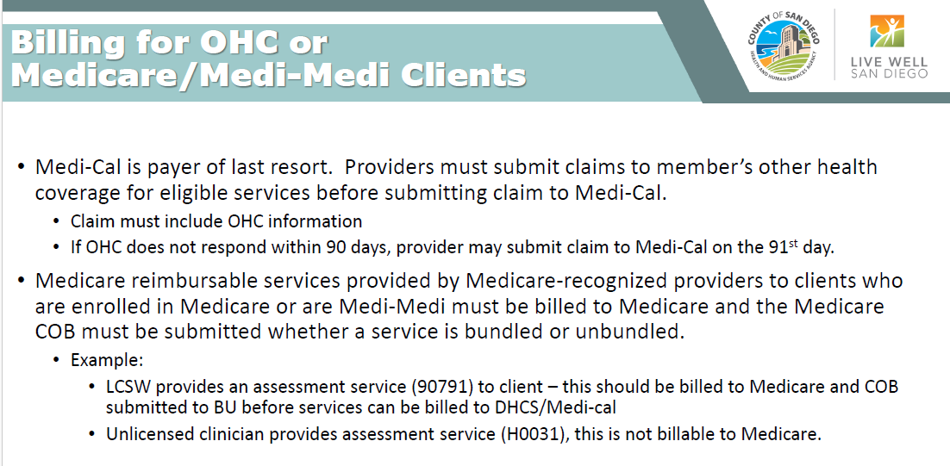
ACT-FACT EBP Bundled Rate Claiming Presentation

Slide 8
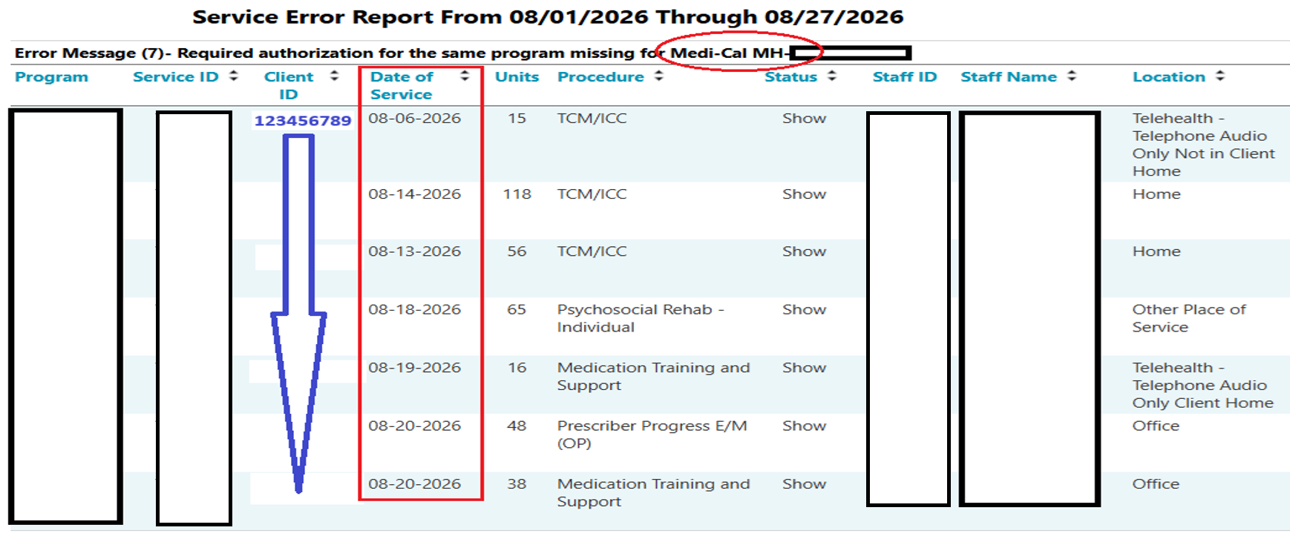
CoSD Service Error Report
Notes:
CoSD Service Error Report should be run frequently to catch errors that

Slide 9
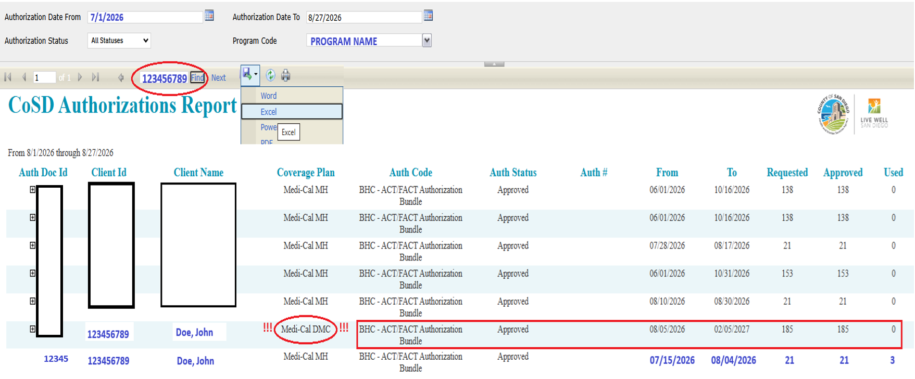
CoSD Authorizations Report
Notes:
For SmartCare Rx only (versus CalMHSA Rx), specifically home medications (self-reported), an issue has been identified where entering a value in the Date Initiated field can overwrite the Start Date when an End Date is not entered. This may result in inaccurate medication date information.
Until this issue is resolved, please do not populate the Date Initiated field for home (self-reported) medications. Instead, document medication dates using only the Start Date and End Date fields.
CalMHSA is actively working with Streamline on a permanent fix. An estimated timeline for the resolution will be shared as soon as it becomes available.

Slide 10
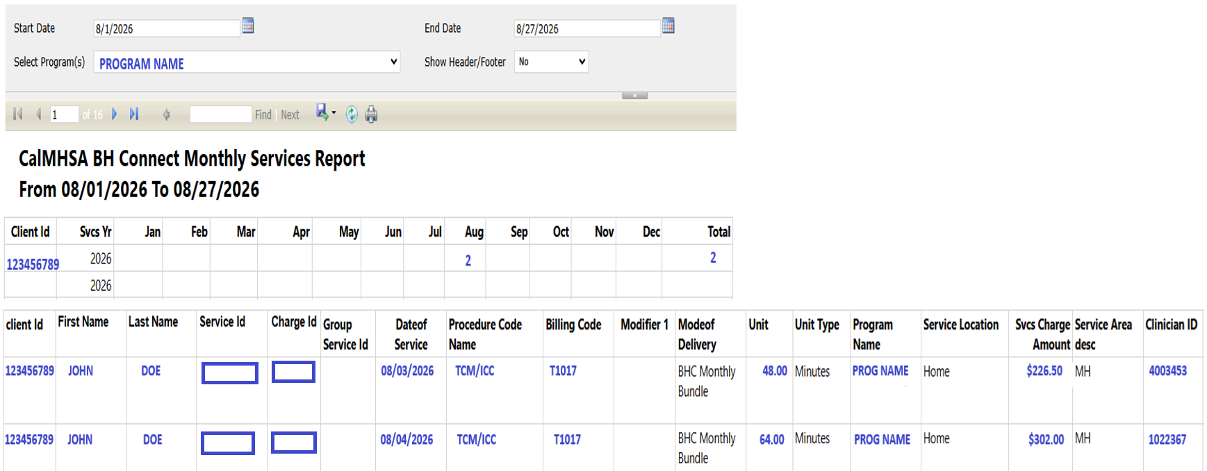
CalMHSA 120 – BH Connect Monthly Services Report
Notes:
You should still document your Client’s consent preferences, even if they decline the disclosure of any data authorized by the Form by selecting the “No” checkbox. This avoids re-requesting your Client’s consent to share their data and records their request to not share that data.
Signing the Form is optional, and your Client may decline to complete the Form.

Slide 11
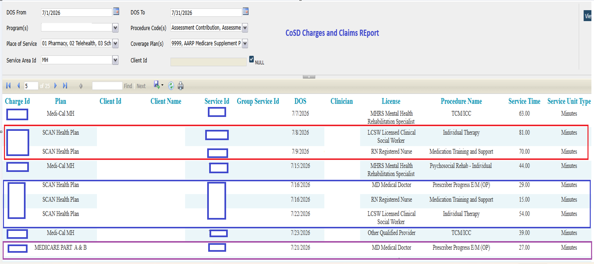
CoSD Charges and Claims Report

Slide 12

Report Training and Resources
Current Efforts
  Optum SmartCare Training
  SmartCare Help Desk Support
  SmartCare ARF: Treatment Programs
  Centralized E-mail support:
  BHS-DataScience.HHSA@sdcounty.ca.gov

Slide 13
Who to Contact?
Who to Contact | How to Contact
SmartCare System issues: i.e. glitches, functionality issues, pop-up errors | CalMHSA various options: 1. Connect via Live Chat (M-F 8:00am – 5:00pm) a. 2023.calmhsa.org b. Access when logged in to the SmartCare EHR 2. Submit a ticket (M-F 8:00am – 5:00pm) a. 2023.calmhsa.org b. Access when logged in to the SmartCare HER 3. After Hours support (only available for system outages) a. Call (916) 214-8348
Password Resets and Account Unlock | Call 1-800-834-3792 (Available daily from 4:30am – 11:00pm including weekends and holidays)
SmartCare ARF submission and any access related issues or questions | BHS_EHRAccessRequest.HHSA@sdcounty.ca.gov
SmartCare support questions that cannot be addressed by the CalMHSA Support Desk should be directed to MIS | BHS_EHRSupport.HHSA@sdcounty.ca.gov
For questions related to documentation guidelines, DHCS regulations or policy | QIMatters.HHSA@sdcounty.ca.gov
Billing Issues or Questions that cannot be addressed by the CalMHSA Help Desk | Mental Health: MHBillingUnit.BHS@sdcounty.ca.gov MH Billing Line: 619-338-2612 SUD: SUDBillingUnit.BHS@sdcounty.ca.gov SUD Billing Line: 619-338-2584
Reports and Data Questions | BHS-DataScience.HHSA@sdcounty.ca.gov

